Slide 1



CryptoBot- Price Prediction
Final Project
Gonzalo Begara
Notes:
Being back to our costumer focus / customer council
Innovation / External orientation.
Innovation mindset (not only FTEs)

Slide 2
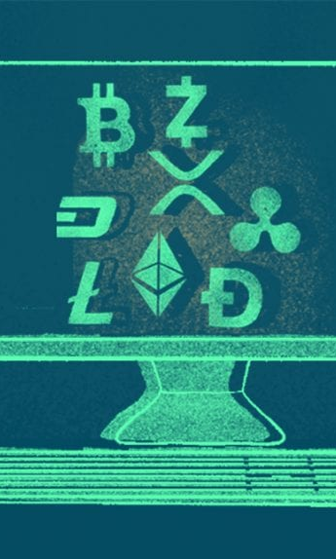

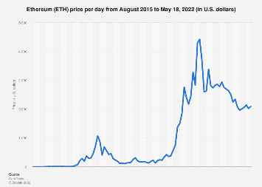




Stages
1
ONE COIN AND ONE YEAR
2
ONE COIN VARIOUS YEARS
3
MORE THAN ONE COIN FOR VARIOUS YEARS

